Slide 1


Advanced Computer Architecture Fall 2019
Hamed Farbeh
farbeh@aut.ac.ir
Department of Computer Engineering
Amirkabir University of Technology
Lecture 5

Slide 2
Copyright Notice
Lectures adopted from
Computer Architecture: A Quantitative Approach, 5th edition, John L. Hennessy,‎ David A. Patterson, MK pub., 2019
Advanced Computer Architecture-Spring 2018, AUT, Tehran, Iran

Slide 3
Computer Architecture
A Quantitative Approach, Sixth Edition
Chapter 3
Instruction-Level Parallelism and Its Exploitation

Slide 4
Multiple Issue and Static Scheduling
To achieve CPI < 1, need to complete multiple instructions per clock
Solutions:
Statically scheduled superscalar processors
VLIW (very long instruction word) processors
Dynamically scheduled superscalar processors
Multiple Issue and Static Scheduling

Slide 5
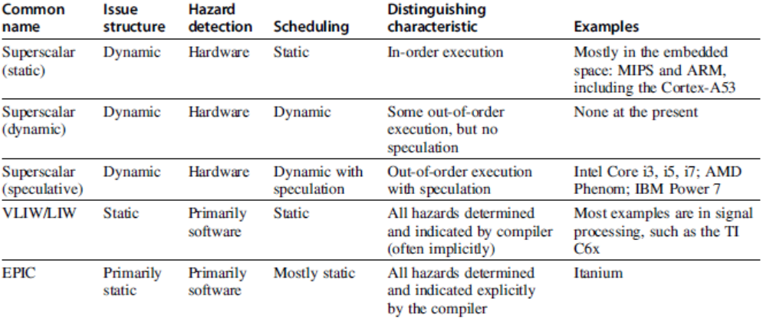
Multiple Issue
Multiple Issue and Static Scheduling

Slide 6
VLIW Processors
Package multiple operations into one instruction
Example VLIW processor:
One integer instruction (or branch)
Two independent floating-point operations
Two independent memory references
Must be enough parallelism in code to fill the available slots
Multiple Issue and Static Scheduling

Slide 7
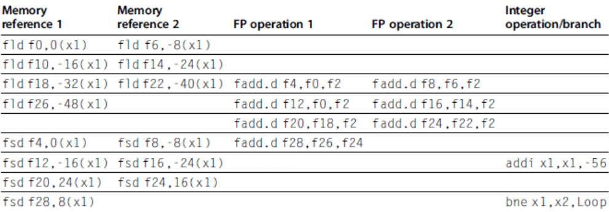
VLIW Processors
Multiple Issue and Static Scheduling
Disadvantages:
Statically finding parallelism
Code size
No hazard detection hardware
Binary code compatibility

Slide 8
Dynamic Scheduling, Multiple Issue, and Speculation
Modern microarchitectures:
Dynamic scheduling + multiple issue + speculation
Two approaches:
Assign reservation stations and update pipeline control table in half clock cycles
Only supports 2 instructions/clock
Design logic to handle any possible dependencies between the instructions
Issue logic is the bottleneck in dynamically scheduled superscalars
Dynamic Scheduling, Multiple Issue, and Speculation

Slide 9
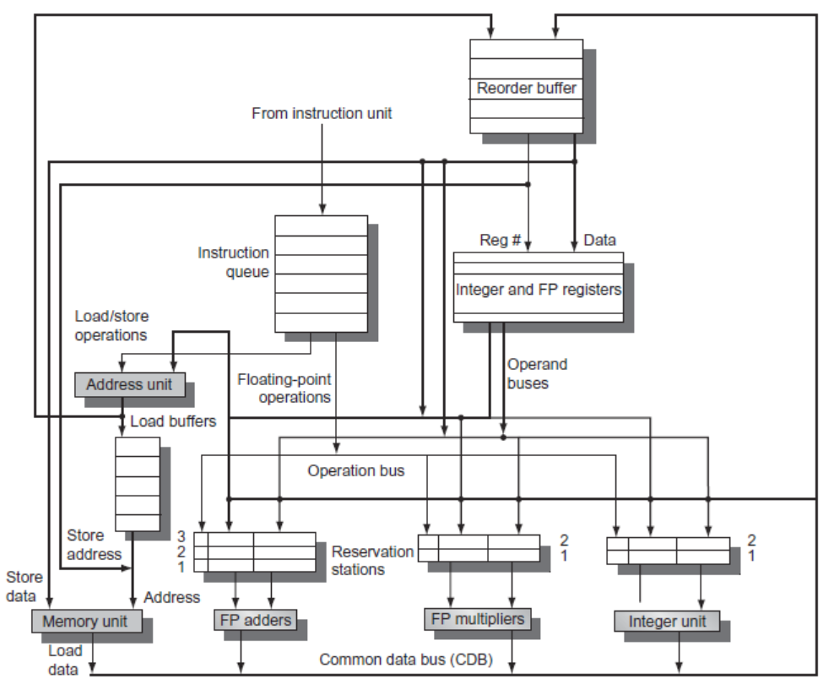
Overview of Design
Dynamic Scheduling, Multiple Issue, and Speculation

Slide 10
Multiple Issue
Examine all the dependencies among the instructions in the bundle
If dependencies exist in bundle, encode them in reservation stations
Also need multiple completion/commit
To simplify RS allocation:
Limit the number of instructions of a given class that can be issued in a “bundle”, i.e. on FP, one integer, one load, one store
Dynamic Scheduling, Multiple Issue, and Speculation

Slide 11
Example
Loop: ld x2,0(x1) //x2=array element
addi x2,x2,1 //increment x2
sd x2,0(x1) //store result
addi x1,x1,8 //increment pointer
bne x2,x3,Loop //branch if not last
Dynamic Scheduling, Multiple Issue, and Speculation

Slide 12
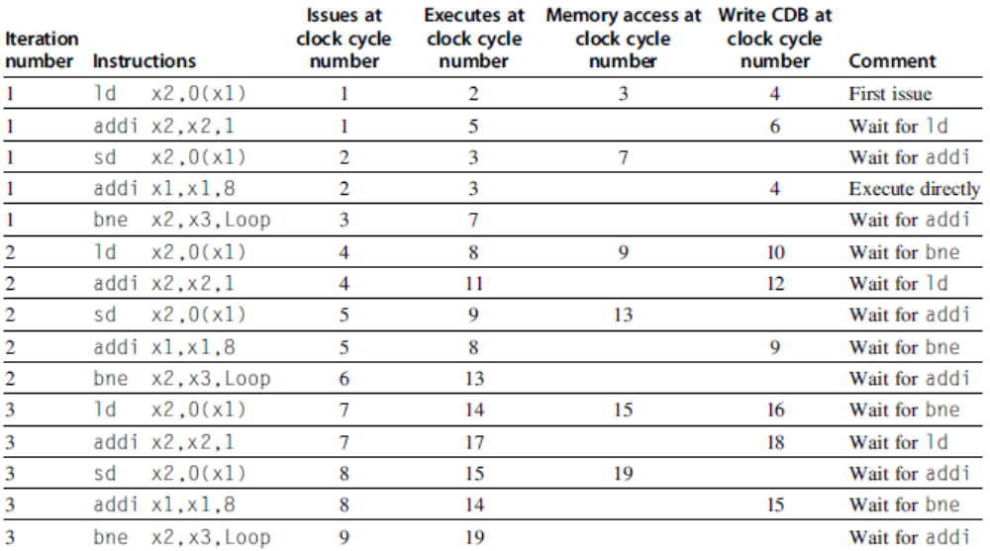
Example (No Speculation)
Dynamic Scheduling, Multiple Issue, and Speculation

Slide 13
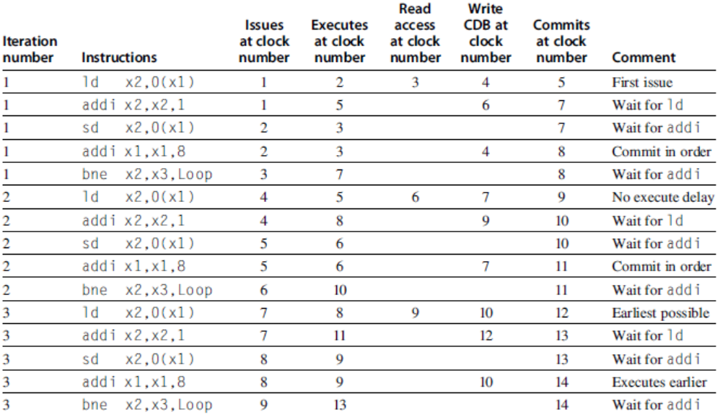
Example (Mutiple Issue with Speculation)
Dynamic Scheduling, Multiple Issue, and Speculation

